Slide 1
iRate
A Database for Managing Movie Ratings
Sichen Wang & Linyi Gao
2019.6.24

Slide 2
01
Background
02
Table Design
CONTENTS
03
Table Edit
04
Table Query
05
Conclusion

Slide 3
01
Background

Slide 4
01 Background
This project is a portion of a an application that enables registered movie theater customers to rate a movie that they saw at the theater, and for other registered customers to vote for reviews.
It encourages theater customers to rate a movie that they saw at the theater in the past week and write a short review.
Other costumers can vote one review of a particular movie as "helpful" each day.
Voting is closed for all reviews of the movie written three days ago.
The writer of the top rated review of a movie written three days earlier receives a free movie ticket.
Someone who voted one or more movie reviews as "helpful" on a given day will be chosen to receive a free concession item.

Slide 5
02
Table Design

Slide 6
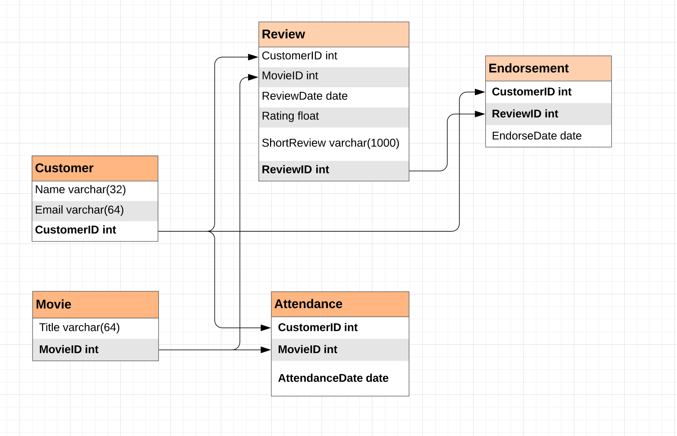
02 Table Design – Creating the table

Slide 7
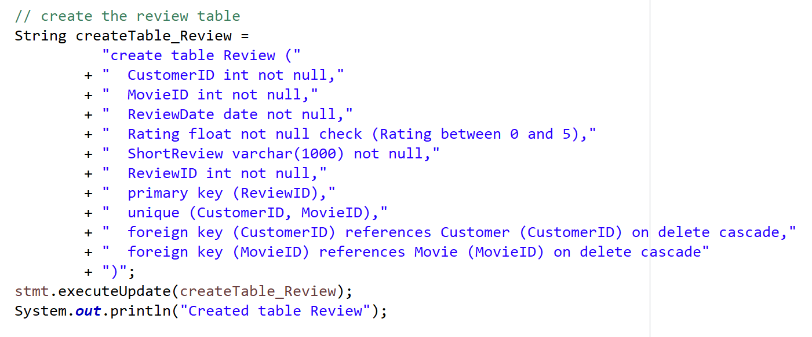
02 Table Design – Some details
Set “NOT NULL” for each entity
Check Review.Rating between 0 and 5
In table Review, set CustomerID and MovieID as “UNIQUE” so that each customer can only write one review for each movie
Add foreign key constraints “ON DELETE CASCADE” so that when a customer, a movie or a review is deleted, make sure that all information relating to it would be deleted as well

Slide 8
03
Table Edit

Slide 9
03 Table Edit
Insert a data to a table
Update a data of a table
Delete a data from a table

Slide 10
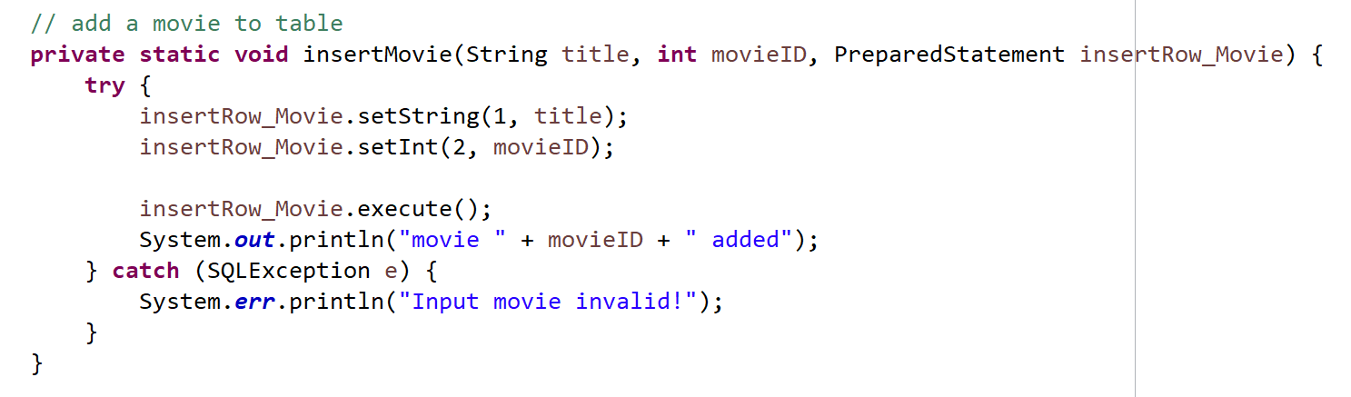
03 Table Edit – Insert
Insert Customer, Movie and Attendance
Using prepared statements
No extra checking before inserting

Slide 11
03 Table Edit – Insert
Insert a review – some requirements:
The date of the review must be within 7 days of the most recent attendance of the movie
Cannot write a review for a movie the customer has not watched
Our solutions before the insert operation:
Search for the most recent attendance date from table Attendance using CustomerID and MovieID
If we cannot find a record, the customer has not watched the movie he is writing review for
Otherwise we compare the date we find with the review date to check the first requirement

Slide 12
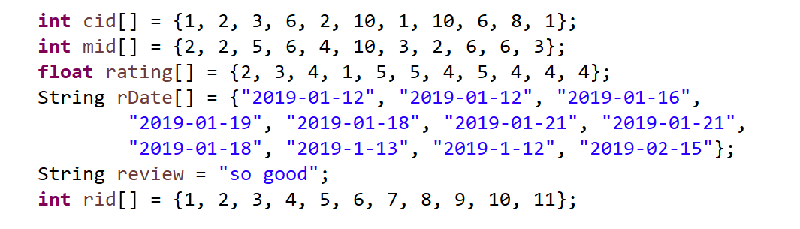
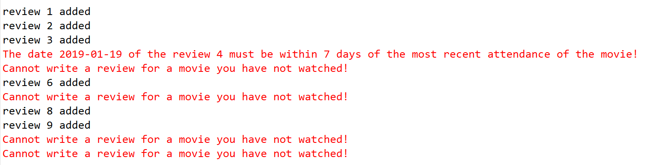
03 Table Edit – Insert
Insert a review – our samples
Results

Slide 13
03 Table Edit – Insert
Insert an endorsement – some requirements:
A customer's current endorsement of a review for a movie must be at least one day after the customer's endorsement of a review for the same movie.
A customer cannot endorse his or her own review
The endorsement date cannot be three or more days after the review date
Our solutions before the insert operation:
Search this review from the Review table to check if the review is written by this customer
Compare the review date and endorsement date to check the third requirement
Search the most recent endorsement date from this customer for the same movie from Endorsement and Review table (join)

Slide 14
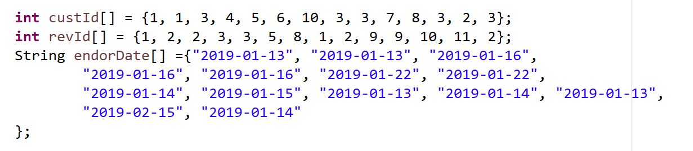
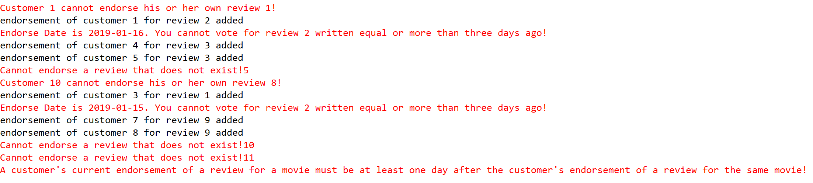
03 Table Edit – Insert
Insert an endorsement – our samples
Results

Slide 15
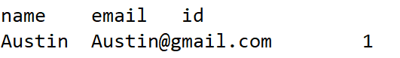
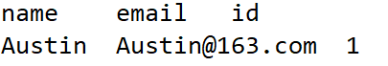
03 Table Edit – Update
We can only update customer’s personal information

Slide 16
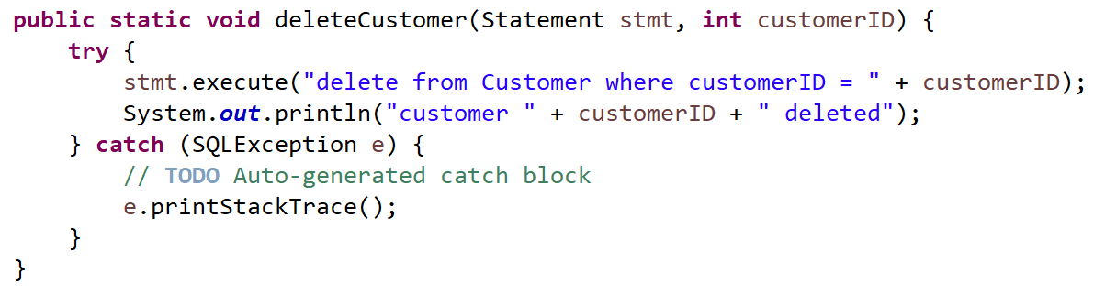
03 Table Edit – Delete
We can delete data from Customer, Movie and Review
“ON DELETE CASCADE” makes sure that all related data will also be deleted

Slide 17
04
Table Query

Slide 18
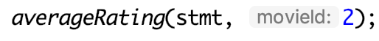
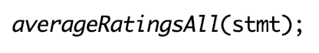
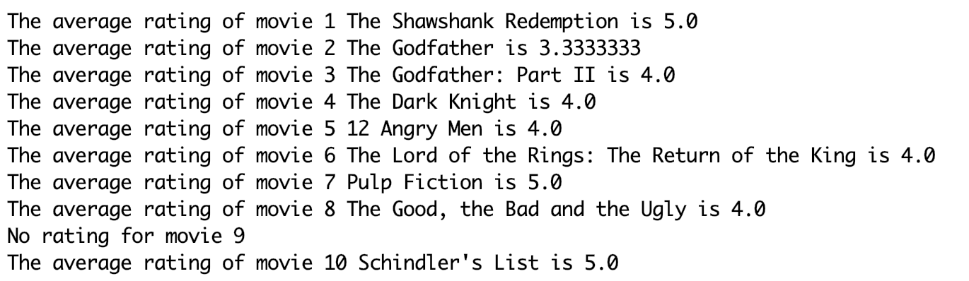
04 Table Query – Average Rating
Query the average rating of a given movie and all movies

Slide 19
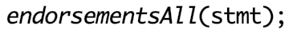
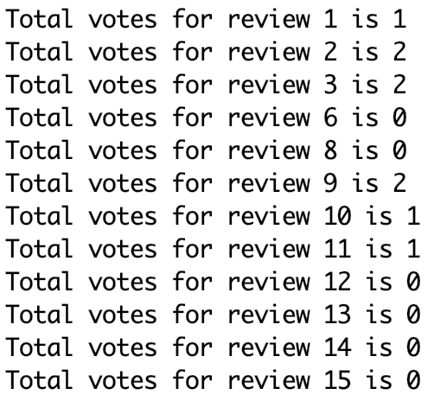
04 Table Query – Endorsements of Reviews
Query the number of endorsements of a given review and all reviews

Slide 20
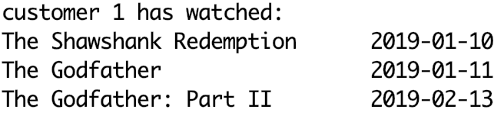
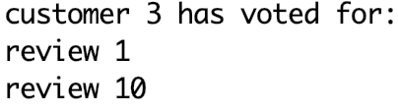
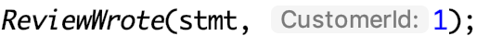
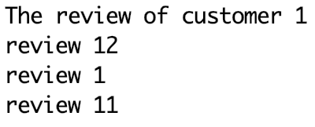
04 Table Query – Customer's watched movies, reviews, and endorsements
Query the movies the Customer watched
Query the reviews the Customer wrote
Query the reviews the Customer endorsed

Slide 21
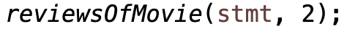
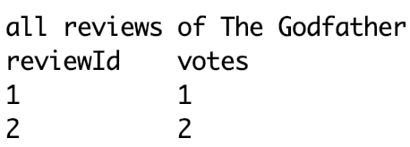
04 Table Query – Movie's reviews and their votes
Query the reviews with their votes of a given movie

Slide 22
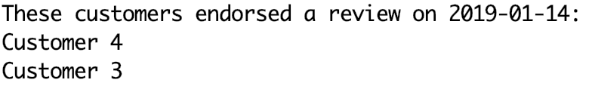
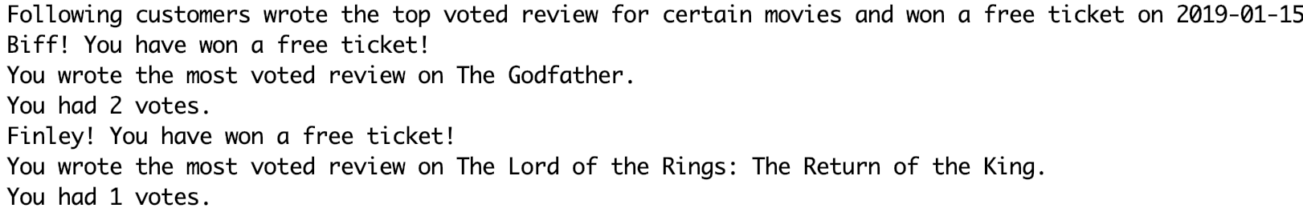
04 Table Query – Featured functions
Query the customers endorsing reviews on a given day
Query the writers who have wrote most voted reviews of movies 3 days ago

Slide 23
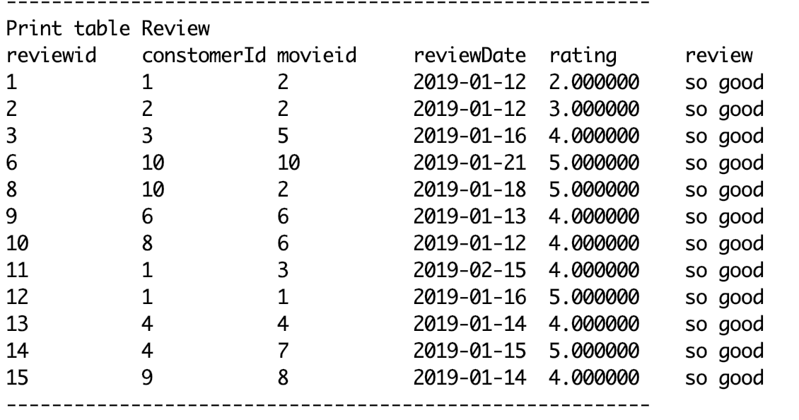
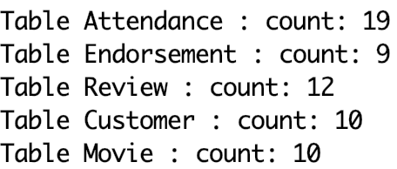
04 Table Query – Tables
Query all tables: Customers, Movies, Attendance, Reviews, Endorsements
Query all tables: Number of rows of all tables

Slide 24
THANK YOU!

